Slide 1

Project- 1Mg Homeopathic Bit-Bhoomi-2345 IA Manager-RishabhSengar Team Member- 1) Shivam Mishra(ft32_058) 2) Dinkar Govindbhai Saroj() 3) Keerthana Prasannan() 4) Ruchi() 5) Keerthishankar Punchithaya ()

Slide 2
Content-
Web Scrapping
Selenium
Beautiful Soup
Dashboard
Power BI
Natural Language Processinig
Sentiment Analysis
TextBlob Analysis

Slide 3
Automating Web Scraping with Selenium
Web scraping as the process of extracting data from websites.
Importance of web scraping in various fields like data analysis, research, and competitive intelligence.
Selenium as an open-source automation tool primarily used for testing web applications and to scrap the data from the websites.

Slide 4
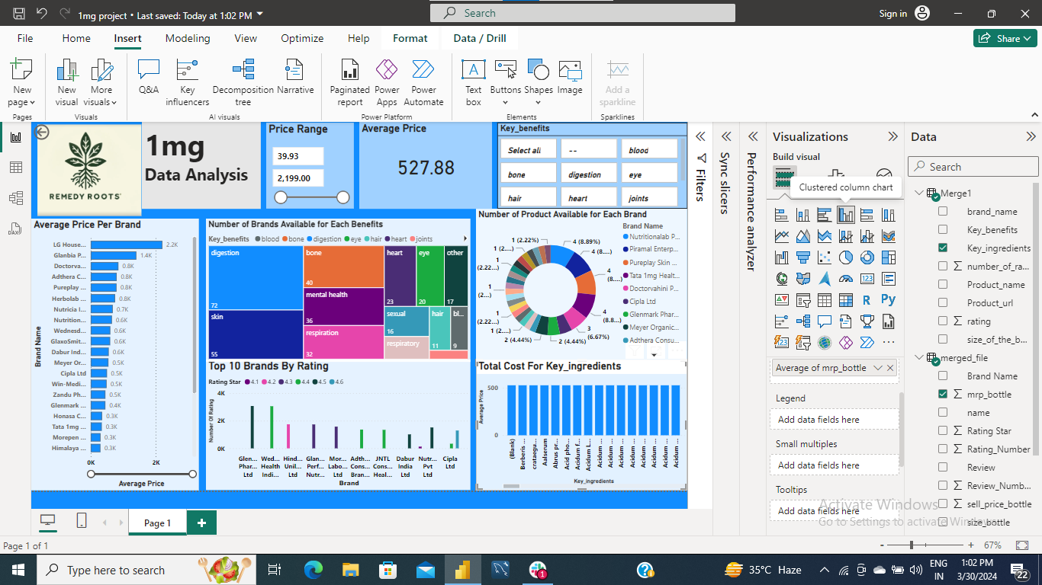
Power BI Dashboard: Insights into Medicine Data

Slide 5
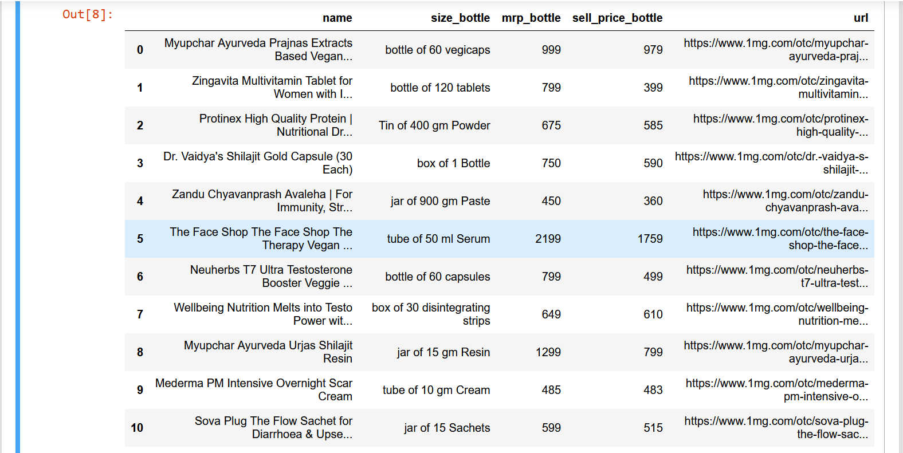
Dataset Creation-
Create the Table 1 with the 45 rows and 5 columns.
This table contain the name, size of the bottle,MRP of bottle,price of bottle,1mg_url.

Slide 6
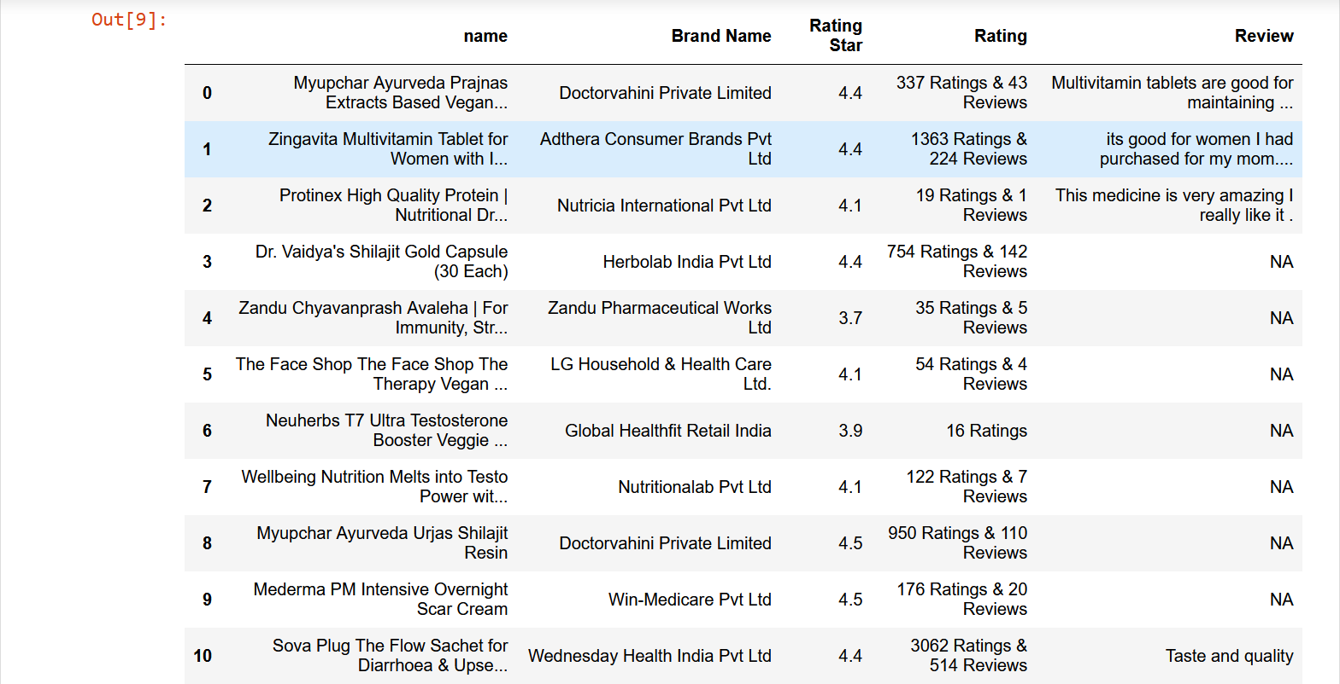
Dataset Creation-
Create the table 2 with 45 rows and 4 columns
This table contain the Brand Name,Rating Star,Rating,Review.

Slide 7
Natural Language Processing-
In the NLP we use the library Natural Language Toolkit(nltk).
NLTK stands for Natural Language Toolkit. It is a leading platform for building Python programs to work with human language data
Key Features: Tokenization, stemming, lemmatization, parsing, and more.

Slide 8
Tokenization-
Tokenization is the process of breaking down text into smaller units, such as words or sentences
Example: Show a sentence and its tokenized form using NLTK.
Visual: Illustration showing text being segmented into tokens.

Slide 9
Stemming and Lemmatization-
Stemming reduces words to their root form
lemmatization converts words to their base or dictionary form
Demonstrate stemming and lemmatization of words using NLTK
Comparison of original words with their stemmed/lemmatized forms

Slide 10
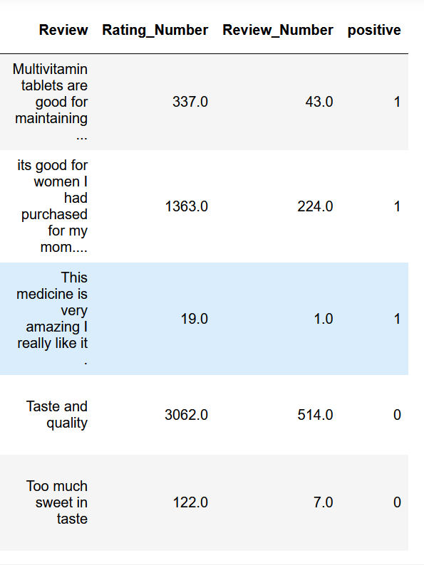
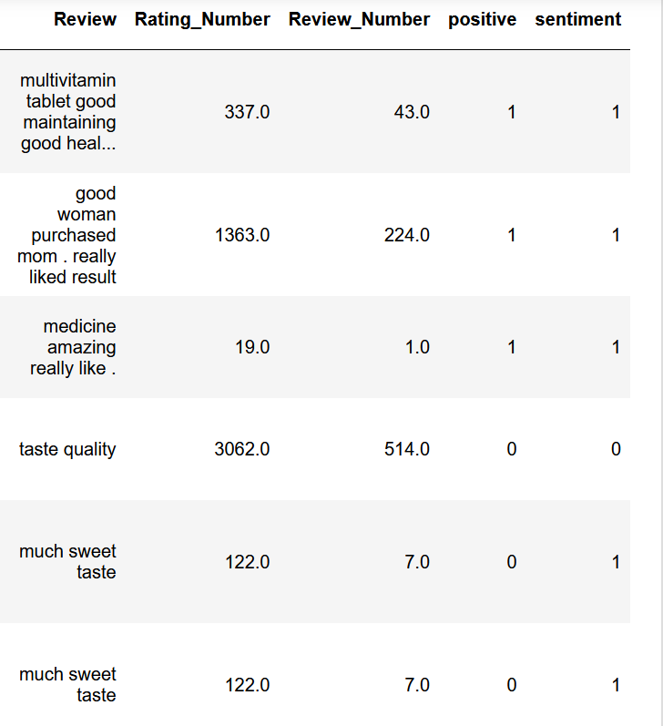
Sentiment Analysis-
NLTK enables sentiment analysis, determining the sentiment or emotional tone of text.
Showcase sentiment analysis results for a sample text using NLTK
Visualization of sentiment scores or polarities assigned to the text.

Slide 11
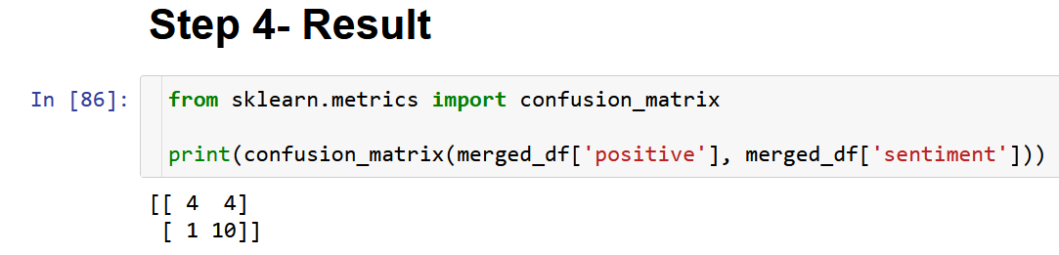
Result-
Confusion matrix it show –
True Positive -4
False positive-4
False negative-1
True negative -10

Slide 12
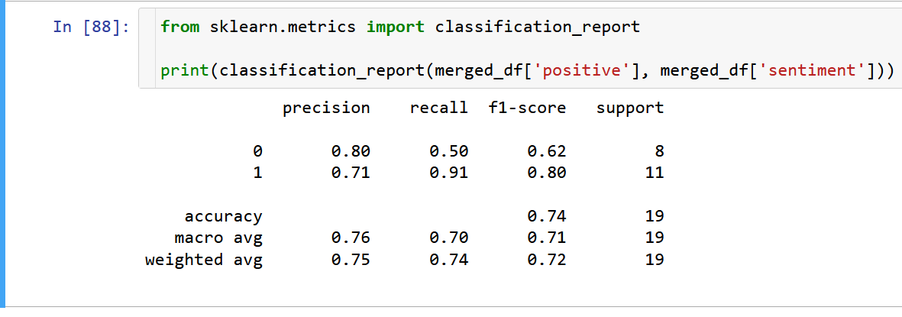
Result-
Here from the data we see that out F1- score value is coming above 0.5 .
So the our model on sentiment Analysis of the review prediction(positive and negative) is performing better.

Slide 13
.
Thanks

